Slide 1

Scaling storage with cloud filesharing services
Greg Vernon
greg.vernon@switch.ch
Krakow, 31 January 2018

Slide 2
SWITCH
We are the Swiss National Research and Education Network.
We network the Institutes of Higher Education and Research to each other, and the rest of the world.
We provide additional services such as Federated Authentication, Video, and File Sharing to our Educational customers.
We manage the Top Level Domains for Switzerland (.ch) and Liechtenstein (.li).
We provide SWITCH-CERT security service.

Slide 3





Our customers
SWITCH community
Swiss universities on tertiary level (academic sector) and their research institutions
Extended community
Other organizations involved in research or education
Commercial customers
Registrars of .ch- and .li-Domain-Names, Swiss financial institutions, research-related industry and government

Slide 4
SWITCHdrive
SWITCHdrive is our branded ownCloud offering. We have the following:
About 30,000 Users
125,000,000 files
125,000,000 rows in our oc_filecache table
3 Mariadb servers in a Galera cluster
9 Apache Servers(4 Sync/4 Web/1 Management)
Redis
3 LDAP Servers
5 NFS servers running atop CEPH (130 TB currently)
2 HAproxy load balancers
Monitoring (Graphite, ELK)
Runs atop SWITCHengines, our OpenStack offering
Most services are Docker containers

Slide 5
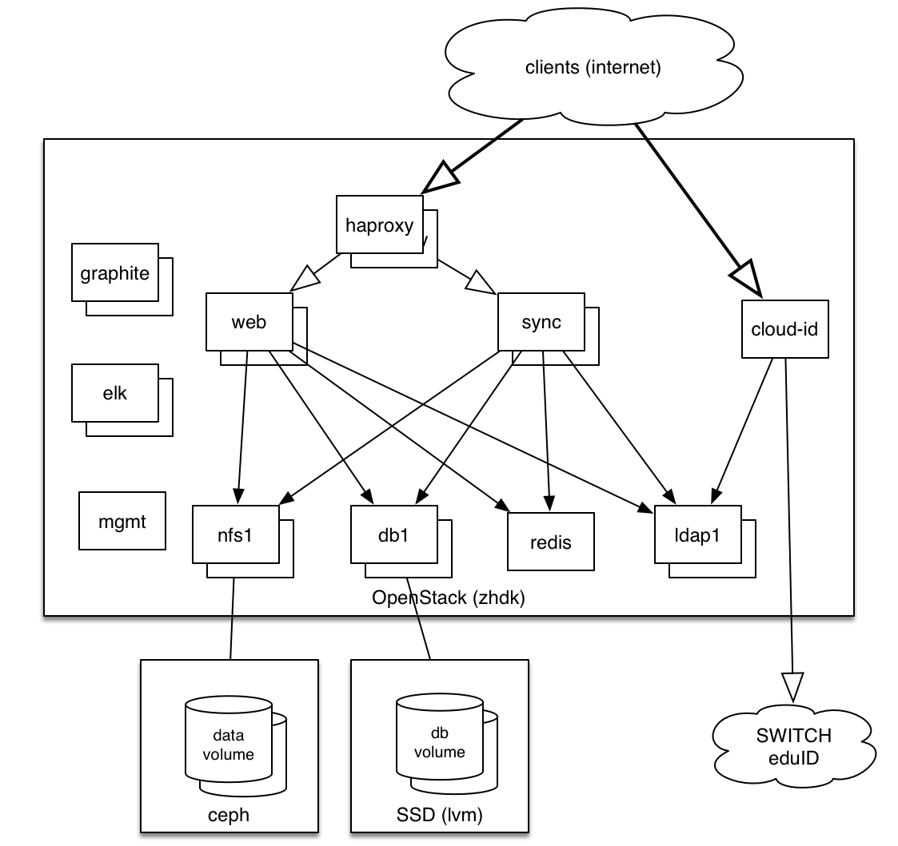

Slide 6
At the beginning...
There was FileSender on Amazon
Storage was s3.
Hosting was in Dublin, so the network was the bottleneck, which we saw when we did some benchmarking.
It wasn't fast.
But it was scalable.
Notes:
I had a really cool video comparing the speeds, but it has someone’s actual email in it, so I can only describe it.

Slide 7
"Don't use the Cloud, be the Cloud"
SWITCHdrive on our 'Building Cloud Competence’ experimental service
OpenStack infrastructure
Ceph storage
Speeds were USB1. ☹

Slide 8
Filesender Redux
We brought FileSender back as a service, as SWITCHdrive was going through teething pains
Storage is now Ceph, but still slow.
Expanding volumes take significant time as data must be copied.
Snapshots via OpenStack were glacially slow.
Used LVM to abstract the data layer, so volumes can be grown without having to take an outage.
Over time the Ceph storage has become faster, we rarely see any complaints from users.

Slide 9
So, what exactly is Ceph?
Ceph is a horizontally distributed storage system
block storage (which we always use)
S3-like object storage (which is interesting)
posix file storage (CephFS)
Very little overhead between storage and clients.
There are separate nodes that allow for redundant storage devices (in our case, mostly spinning rust).
It's popular among OpenStack operators, including SWITCHengines, which is what we use for our SWITCHdrive system.
Distributed using CRUSH algorithm that hashes, a client will know exactly which device it will talk to.
For replicated storage, the client can contact any of the replicas and will get the exact result.
OSDs are the atomic units, and there are three for every Ceph volume.

Slide 10
What is Ceph? (continued)
OSDs do journaling to (we use SSDs here), master writes request in journal, then syncs with other two, and then in background writes to spinning rust. Basically like a DB write-ahead log. The SSDs have advanced power-loss protection, and the SSDs cheat by using their RAM buffer, and we're battery-backed (with capacitors, enough to keep it with the ability to write to flash)
You have a HUGE number of small 4MB objects that _should_ be distributed among many servers (more servers == faster) you hope this is random to get the distribution nicely sorted.

Slide 11
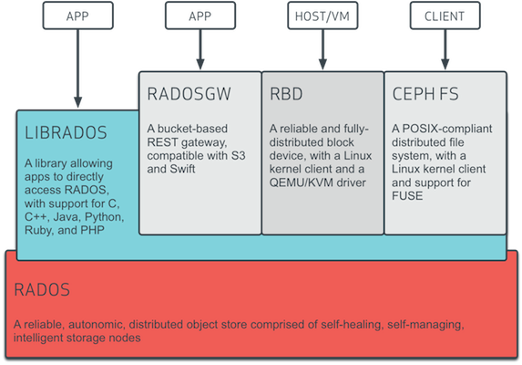
Ceph Architecture
(Source: http://docs.ceph.com/docs/giant/architecture/)

Slide 12
Why use Ceph?
It's relatively cheap
It's relatively safe
It works well, and is well supported, with OpenStack
It has very smooth scaling
It is flexible, you can mismatch hardware without problems, except that your slowest devices will define your speeds

Slide 13
Is it slow?
NO! Ceph is not slow any longer. We did some testing with fio, and found that it is reasonably fast for network storage. Not lighting quick, but (fast|cheap|safe), and we're cheap and safe.
fio: https://github.com/axboe/fio
Ceph + NFS + XFS is slow, but we don't know exactly why, but we strongly suspect that there is an issue with large numbers of small files in single directories.
Ceph snapshots are cheap to make, but really expensive to remove.
Our current limitations might have more to do with our architecture than Ceph itself.

Slide 14
SWITCHdrive Today
Stable service.
Some Ceph Turbulance from deleting snapshots.
Some issues with directories with many small files.
But we think it could be faster.

Slide 15
SWITCHdrive in the future
Ceph stays.
Ceph Object storage (with ownCloud 10).
zfs replacing xfs, and replacing Ceph snapshotting
using zfs for offsite disaster recovery.
Using a zfs pool to replace all of the nfs volumes, but we still have the large number of Ceph volumes.
Notes:
We currently use ZFS snapshotting to back up our mail server, and it works very well.

Slide 16
Questions
Email: greg.vernon@switch.ch

Slide 17
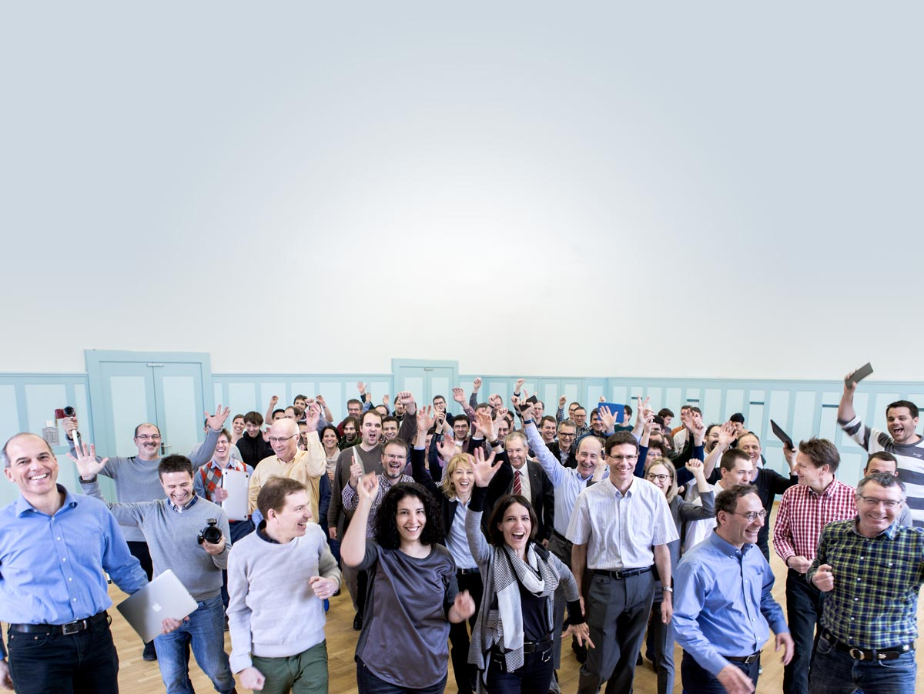



SWITCH – an integral part of the Swiss academic community since 1987.
www.switch.ch/30years
Notes:
SWITCH wird dieses Jahr 30 Jahre alt. Einen runden Geburtstag zu feiern ist stets auch eine gute Möglichkeit kurz zurück zu schauen, aber auch einen Blick in die Zukunft zu wagen. Alle Informationen rund um das Jubliäum finden Sie hier auf unserer Webseite: www.switch.ch/30years

